Slide 1
Service-oriented Software Engineering (SoSE) Midterm test homework
Securing SOAP and REST Services with Apache CXF
Adam Bouafia
University of L’Aquila
Adam..bouafia@student.univaq.it

Slide 2


Introduction to Apache CXF
Open Source Framework: Facilitates community contributions and enhances transparency in development.
is an open-source services framework that assists developers in building and deploying services using front-end programming APIs like JAX-WS and JAX-RS. It simplifies complex programming tasks involved in web services development and ensures compatibility across different web service standards.
Supports Multiple Protocols: Including SOAP for service-oriented architecture and REST for web services, making it versatile for developers.
Apache CXF is managed by an active community within the Apache Software Foundation,
ensuring it remains robust and up-to-date with security standards and web technologies.
Flexibility: CXF's support for multiple communication protocols allows developers to work effectively across different types of web services, enhancing its utility in diverse development environments.

Slide 3
A bit of history
. Origins: Began as a merger between two projects - Celtix from IONA and XFire from Codehaus - forming CXF under the Apache Software Foundation.
the collaboration led to a more unified and powerful framework under the Apache umbrella, emphasizing the community-driven aspect of its development.
Development: Focused on creating a robust, extensible framework for web services, incorporating both SOAP and REST architectures.
Supported key standards like ‘SOAP’ , ‘WSDL’ , ‘JAX-WS’ , ‘JAX-RS’ , ‘WS-Security”, ‘WS-Addressing’’
Current Version: Using Apache CXF 3.4.3 in our project, ensuring up-to-date support for web service standards and security enhancements.
Enhanced Security Features
Stability and Bug Fixes
Compatibility with Java and Other Libraries:
Notes:
Evolving Standards Supported by Apache CXF
Apache CXF has continually evolved to support a broad spectrum of web service standards. This adaptability ensures compatibility and interoperability in diverse IT environments, which is crucial for building robust web service applications. Here are some key standards supported:
SOAP (Simple Object Access Protocol): Ensures compatibility with WS-* specifications which are foundational for enterprise SOAP services.
WSDL (Web Services Description Language): Facilitates the automatic generation of client proxies and implementation skeletons from WSDL documents.
JAX-WS (Java API for XML Web Services): Provides a platform for building and deploying web services according to the WS-I specifications.
JAX-RS (Java API for RESTful Web Services): Supports the development of RESTful web services.
WS-Security: Offers features that help in implementing secure web services, which is crucial for protecting data in transit.
WS-Addressing: Enhances message routing and allows messages to contain routing data, supporting the stateful operations required by some business processes.
Why Version 3.4.3?
Choosing Apache CXF version 3.4.3 for your project was likely influenced by specific features or improvements offered in this release. Here are plausible reasons for selecting this version:
Enhanced Security Features: Version 3.4.3 includes updated WS-Security features, making it a solid choice for projects where security is a priority. This could include better encryption options, improved token support, and more robust configurations for securing web services.
Stability and Bug Fixes: As a later release in the 3.x series, version 3.4.3 includes cumulative bug fixes and stability improvements that make it more reliable for production environments.
Compatibility with Java and Other Libraries: This version ensures better compatibility with newer versions of Java and third-party libraries, which is critical for maintaining an up-to-date tech stack.
Performance Improvements: Enhanced performance in processing SOAP and RESTful requests, which can be crucial for high-load environments.

Slide 4

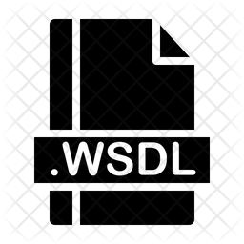

Standards Supported by Apache CXF
CXF supports a variety of web service standards :
SOAP
the Basic Profile
WSDL
WS-Addressing
WS-Policy
WS-ReliableMessaging
WS-Security
WS-SecurityPolicy
WS-SecureConversation
WS-Trust.

Slide 5
Tools Supporting Apache CXF Development
Integrated Development Environments (IDEs) :
Eclipse: Widely used for Java development, with plugins for CXF.
IntelliJ IDEA: Supports CXF through plugins and configuration settings.
NetBeans: Offers support for CXF with additional plugins.
Build Tools :
Maven: Essential for managing project dependencies, configurations, and builds specifically for CXF projects.
Gradle: Another popular tool for building and managing dependencies in Java projects including CXF.
Testing and Debugging Tools :
SoapUI: Highly popular for testing SOAP and REST web services.
Postman: While typically used for REST APIs, it can be configured to test SOAP requests as well.
Version Control Systems :
Git: Recommended for source code management in projects using CXF.

Slide 6
Integrating and Securing the Financial Services Project with Apache CXF
Project Functionality:
Currency Conversion (SOAP WS)
Loan Calculation (SOAP WS)
Investment Prediction (REST WS)
CXF Integration:
Dependency Management (pom.xml)
CXF Configuration (cxf-servlet.xml)
Security Setup (SecurityConfig.java)

Slide 7
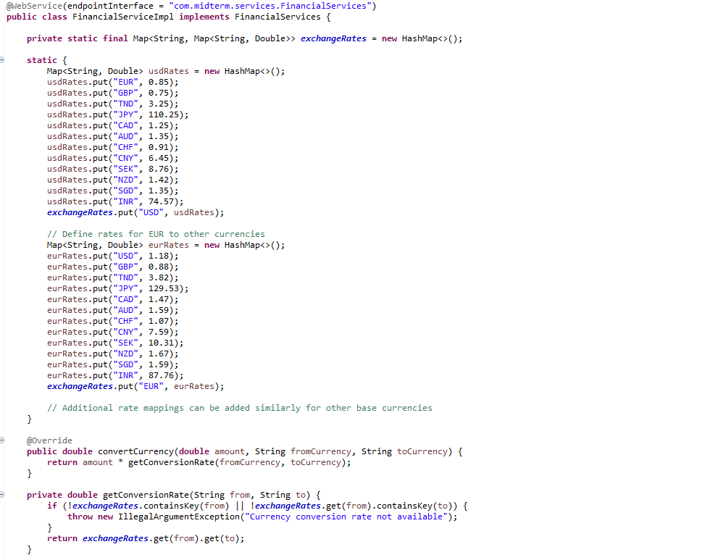
Functional Details:
Currency Conversion
Description: Converts an amount from one currency to another.
Implemented in: FinancialServiceImpl.java
Endpoint Interface: FinancialServices.java
Security: Managed via WS-Security as indicated
by the use of the cxf-rt-security and
cxf-rt-security-saml dependencies.

Slide 8
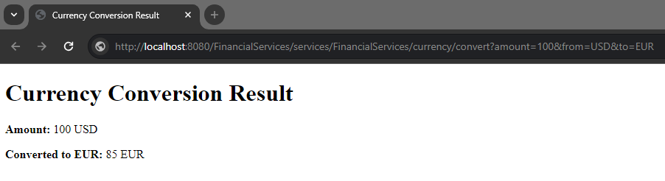
Currency Conversion Service
http://localhost:8080/FinancialServices/services/FinancialServices/currency/convert?amount=100&from=USD&to=EUR

Slide 9
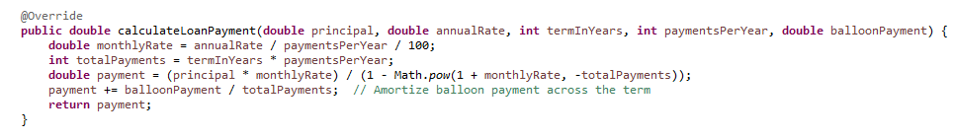
Functional Details:
Loan Calculation
Description: Calculates loan payment details based on input parameters such as principal, rate, term, etc.
Implemented in: FinancialServiceImpl.java
Endpoint Interface: FinancialServices.java
Security: Since this service is marked with RolesAllowed("ADMIN"), it uses role-based access control, indicating an integration of security at the SOAP message level.

Slide 10
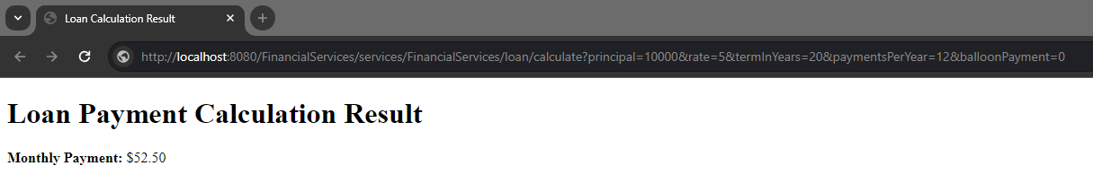
Loan Calculation Service
http://localhost:8080/FinancialServices/services/FinancialServices/loan/calculate?principal=10000&rate=5&termInYears=20&paymentsPerYear=12&balloonPayment=0

Slide 11
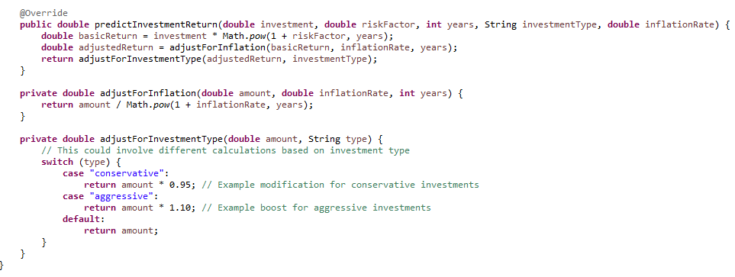
Functional Details:
Investment Prediction
Description: Predicts returns on investments based on various factors like amount, risk, years, and inflation.
Implemented in: FinancialRestService.java
Security: Secured using HTTP Basic Authentication and role-based access, as configured in SecurityConfig.java.

Slide 12
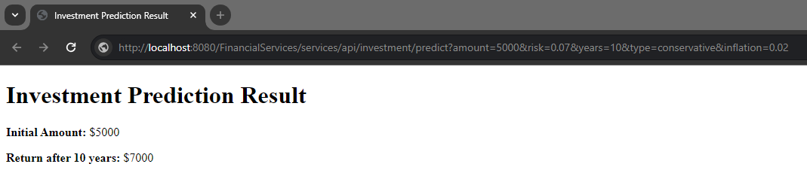
Investment Prediction Service
http://localhost:8080/FinancialServices/services/api/investment/predict?amount=5000&risk=0.07&years=10&type=conservative&inflation=0.02

Slide 13
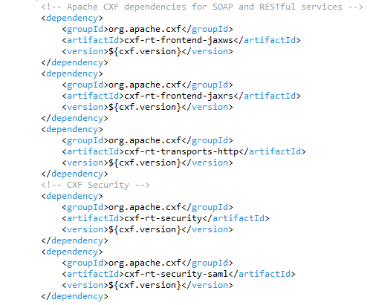
CXF Integration and Configuration:
Dependency Management (pom.xml)

Slide 14
Configuring CXF Security Through Maven Dependencies
CXF Core and Security Libraries:
Core Libraries: Essential for setting up CXF for both SOAP and REST services.
Security Libraries: Specific to adding security capabilities to your CXF setup.
Dependency Listings:
cxf-rt-frontend-jaxws and cxf-rt-frontend-jaxrs: For SOAP and REST services, respectively.
cxf-rt-security: General security integration for CXF.
cxf-rt-security-saml: For implementing SAML-based security, often used in enterprise scenarios.
Purpose of Each Dependency:
cxf-rt-frontend-jaxws: Enables JAX-WS (Java API for XML Web Services), which is fundamental for SOAP services.
cxf-rt-frontend-jaxrs: Enables JAX-RS (Java API for RESTful Web Services), used for building RESTful services.
cxf-rt-transports-http: Supports HTTP transport, used by both SOAP and REST services.
cxf-rt-security: Provides support for integrating standard security features into CXF services.
cxf-rt-security-saml: Adds support for SAML (Security Assertion Markup Language), enhancing the security framework especially for federated identity scenarios.

Slide 15
Configuring CXF Services with cxf-servlet.xml
Purpose of cxf-servlet.xml
Primary Configuration: Establishes the primary servlet that Apache CXF uses to handle requests for SOAP services.
Service Endpoint Declaration: Defines the SOAP service endpoints, linking them to their implementation classes.
Content of cxf-servlet.xml
XML Namespaces:
xmlns:beans: Standard Spring beans.
xmlns:jaxws: JAX-WS specific configurations.
Import Statements:
Imports base CXF configurations which include default settings and capabilities that CXF supports.
Service Endpoint Configuration:
Uses <jaxws:endpoint> to define the SOAP service endpoint.
Specifies id, implementor, and address attributes which are critical for service identification, implementation linking, and URL mapping.
Explanation of Key Attributes
id="financialServices": Unique identifier for the service within the Spring application context.
implementor="com.midterm.services.FinancialServiceImpl": The class that implements the service’s interface.
address="/FinancialServices": The URL path at which the service is available.

Slide 16
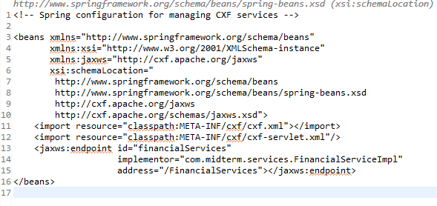
CXF Integration and Configuration:
CXF Configuration (cxf-servlet.xml)
Notes:
For rest and soap

Slide 17
Configuring Security for REST Services with SecurityConfig.java
Purpose of SecurityConfig.java
Configure Web Security: Outlines how security is integrated into the Spring application context to secure REST services.
Use of Spring Security: Leverages Spring Security for implementing robust security measures such as HTTP Basic Authentication.
Content of SecurityConfig.java
Annotations Used:
@Configuration: Indicates that the class has Spring configuration definitions.
@EnableWebSecurity: Activates security features for the Spring application.
Security Configuration Methods:
Methods configure how users are authenticated and how requests are authorized.
Explanation of Key Configuration
User Details and Roles: user credentials and roles are set up in memory for simplicity, noting this isn't recommended for production environments.
Security Rules:
Detail the paths that are secured (/api/**) and the type of security enforced (HTTP Basic).
The roles are required to access different parts of the API.

Slide 18
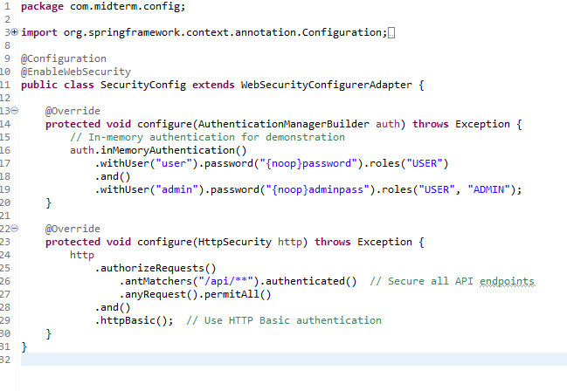
CXF Integration and Configuration:
Security Setup (SecurityConfig.java)
Notes:
For the rest ws

Slide 19

Conclusion: Securing Web Services with Apache CXF
In our project, we implemented critical financial services, leveraging CXF for both SOAP and REST APIs.
For SOAP services, such as currency conversion and loan calculations, we integrated advanced security using WS-Security to ensure data integrity and confidentiality.
For our REST service, the investment prediction functionality, we utilized Spring Security to enforce authentication and authorization, demonstrating CXF's flexibility and compatibility with Spring frameworks.
Notes:
For the rest ws

